Slide 1
Facilitating a favourable investment climate – lessons from Sierra Leone
ANDE Annual Conference 2023
Pooja Melwani

Slide 2
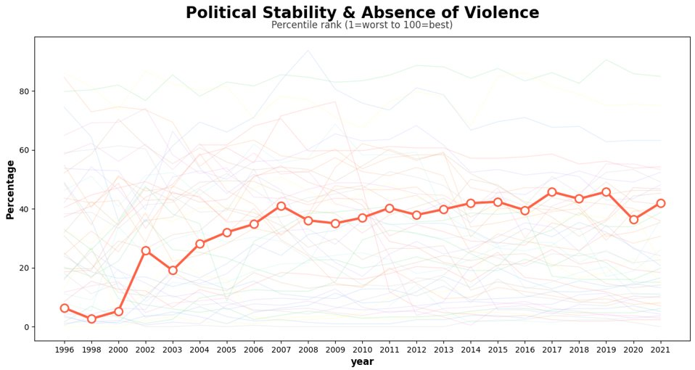
Building on 20 years of improving stability
Source: World Bank Worldwide Governance Indicators; shown for all Sub-Saharan African countries with Sierra Leone highlighted in orange​

Slide 3
How Invest Salone works
We have been working in Sierra Leone since 2019 to help reduce the cost and risk of doing business in Sierra Leone.
We work with businesses, investors, buyers and the public sector.
We use a spectrum of tools, including public-private dialogues, grants, brokering links between producers, buyers, investors and providing technical assistance.

Slide 4
Impact to date
Supported impact investors to unlock £13m in investment for Sierra Leonean businesses
Supported 30+ Sierra Leonean businesses to become more productive and competitive
Published 20+ research papers to inform policies and regulations in support of private sector-led growth
Linking international buyers to Sierra Leonean businesses to promote exports, including for textiles
Introduced innovative financial products to address capital constraints
Supporting Sierra Leonean banks to unlock green finance

Slide 5
Select innovations: tools and impact
Funding green growth
Sustainable finance
Risk sharing grants:
For the private sector to develop or use environmentally sustainable technology and approaches to expand their businesses
To encourage investors who are committed to mitigating the adverse impacts of climate change
We are working with the banking sector on developing a sustainable finance roadmap under the leadership of the Ministry of Finance and the Bank of Sierra Leone
Local currency bond
The first local currency corporate bond approved by the Bank of Sierra Leone

Slide 6
Invest Salone’s offer
Establish linkages between investors and investable businesses in Sierra Leone
Co-fund a trip to Sierra Leone and arrange meetings with potential investees
Provide bespoke assistance in navigating investment climate in Sierra Leone
Fund Technical Assistance for potential investees to make them investment-ready
Award small grants to investors to buy-down investment risk
Facilitate/support FDI investment in Sierra Leone

Slide 7
For collaboration and partnership
Visit: investsalone.com/ANDEconference2023/
Email: pooja.melwani@investsalone.com
Telephone: +232 99 880577
@InvestSalone

